Slide 1
Diabetes Prediction using Supervised Machine Learning
Presented By
Yunus Ahmed
22376011
M.Tech CSE 2nd Sem

Slide 2
Abstract
Diabetes is a disease that can lead to blindness, kidney failure, and heart attacks, as well as death.
According to the International Diabetes Federation, there were 463 million diabetics in 2019. According to an article published by the Ministry of Health of the Republic of Indonesia in 2020, the ten countries with the highest diabetes rates in 2019 include Indonesia.
The ability of experts is required to determine the type of diabetes disease. Because of their delay in discovering what disease they have, many people who are examined have a disease that can be described as severe.
In today's medical world, doctors can use it to quickly and accurately interpret diseases. Because of that we can use machine learning to prevent the death by making an artificial intelligent model that can predict diabetes disease and the method that be used is comparison between the KNN and Naive Bayes algorithms to see which algorithm suit the best for diabetes prediction.
The study concluded by comparing two k-Nearest Neighbor algorithms and the Naive Bayes algorithm to predict diabetes based on several health attributes in the dataset using supervised machine learning.
According to the results of our experiments and evaluating algorithm using Confusion Matrix, the Naive Bayes algorithm outperforms KNN.

Slide 3
Introduction
The ability of experts is required to determine the type of diabetes disease, because of their delay in discovering what disease they have, many people who are examined have a disease that can be described as severe.
Because of this we will compare the KNN and Naive Bayes algorithms to see which algorithm suit the best for diabetes prediction.
The object of this study is the Pima Indians Diabetes dataset, which contains 8 independent variables and 1 dependent variable.
With so many variables to consider in the diagnosis of diabetes, a method that produces results quickly and efficiently is required.
To compare the classification accuracy of various machine learning algorithms if similar data is purchased.
To categorize diabetes using a variety of machine learning algorithms
Contribute ideas for researchers and those interested in using machine learning to classify other diseases.
To make a scientific contribution to the field of health sciences by raising readers' awareness of the characteristics of diabetes.

Slide 4
Proposed model
1. K-Nearest Neighbor: The KNN algorithm is one of the supervised learning techniques, it will calculate the proximity between the old case (training data) and new cases (testing data).
The steps of the KNN algorithm are:
Determine the parameter k, as nearest neighbors (number of nearest neighbors);
Calculate the square of the distance between the new data and the training data using Eucliden;
Sort the closest neighbors that have the minimum distance;
Classify the nearest neighbor according to the value of k;
Determine the classification results based on the majority label.

Slide 5
Contt..
2. Naive Bayes classifier: The Naive Bayes classifier is a simple probabilistic classifier based on the application of the Bayesian theorem (from Bayesian statistics) with the assumption of strong (naive) self-determination.
Naive Bayes can also be called Simple Bayes and Independence Bayes.
This algorithm can predict the probability of class membership, such as the probability of data given a certain class label.
The Naive Bayes classifier assumes that the presence (or absence) of certain features (attributes) of a class is not related to the presence (or absence) of other features when a class variable is given.
The advantages of using the Naïve Bayes algorithm are:
Fast and highly scalable model
Balancing linear with number of predictors and rows
The Naïve Bayes procedure is parallel
Naïve Bayes can be used for binary and multiclass classification

Slide 6
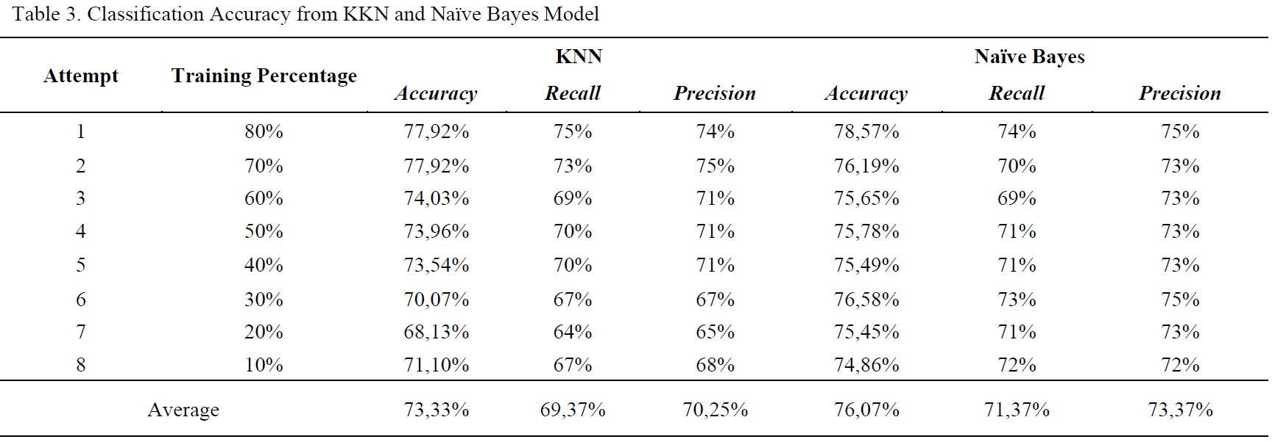
Comparison as per Research Papers

Slide 7
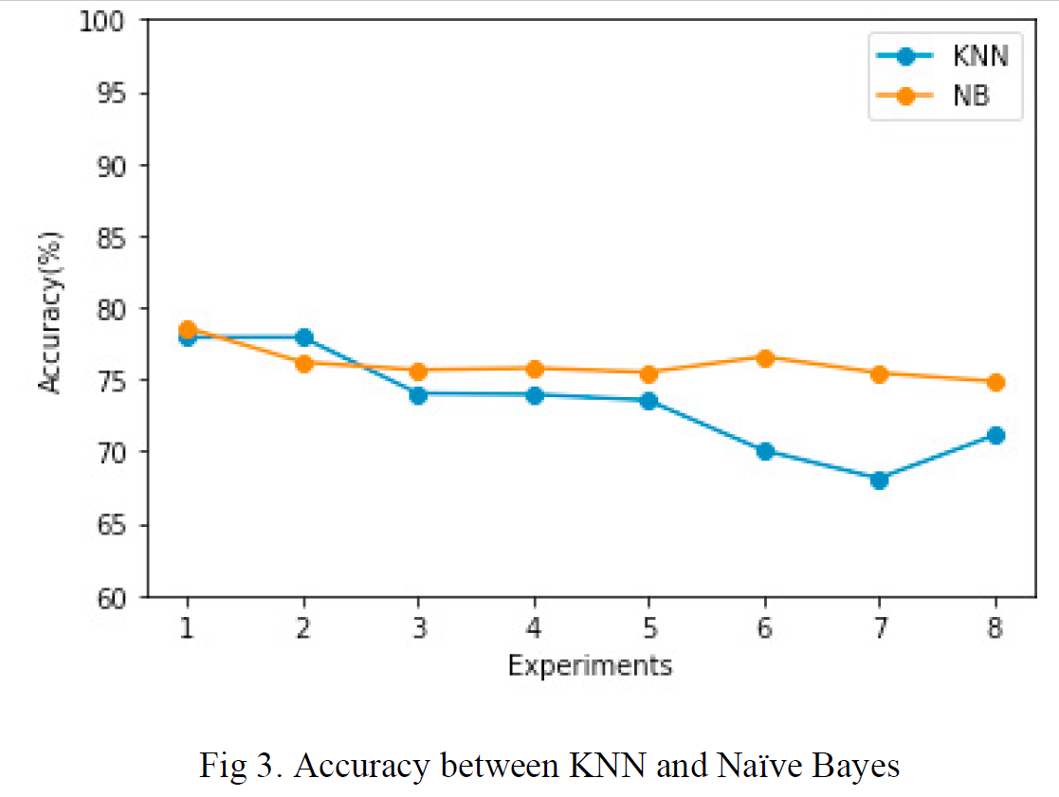
Comparison Graph

Slide 8
Comparison based on my Model
ML Models | Time (Seconds) | Accuracy (%) | Precision (%) | Recall (%) | Mean Squared Error (MSE) | R-squared (R2)
Decision Tree | 0.057135582 | 74.68 | 62.50 | 72.73
SVM | 3.535133123 | 75.32 | 65.45 | 65.45
Logistic Regression | 0.314222813 | 74.68 | 63.79 | 67.27
Random Forest | 0.320694447 | 72.08 | 60.71 | 61.82
KNN | 0.016590834 | 66.23 | 52.46 | 58.18
Naive Bayes | 0.004239321 | 76.62 | 66.10 | 70.91
Deep Learning | 0.894618273 | 69.48 | 63.33 | 34.55
linear Regression | 0.099768639 |  |  |  | 1.071759259 | 0.255

Slide 9
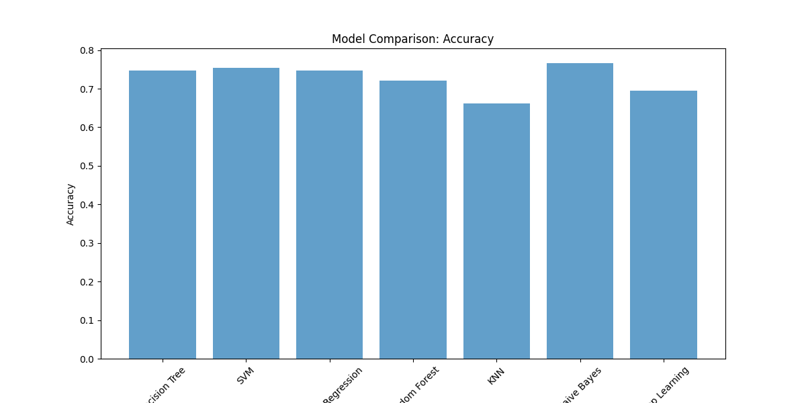
Comparison based on Accuracy

Slide 10
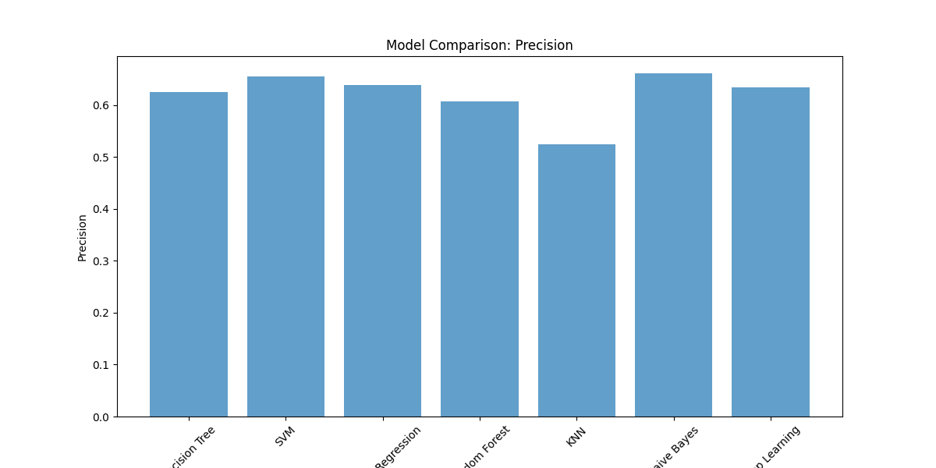
Comparison based on Precision

Slide 11
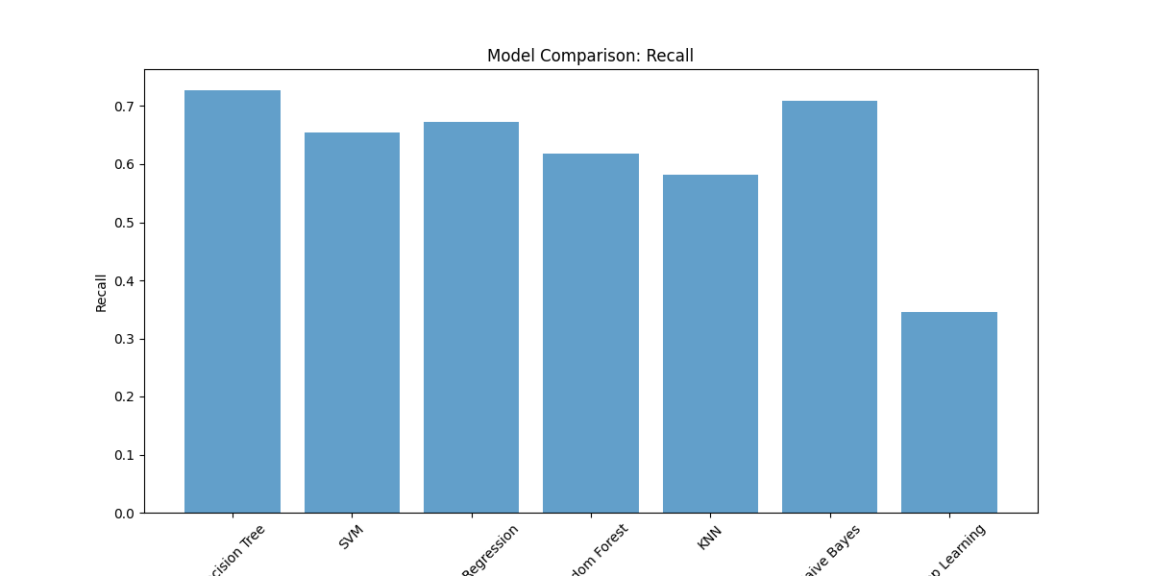
Comparison based on Recall

Slide 12
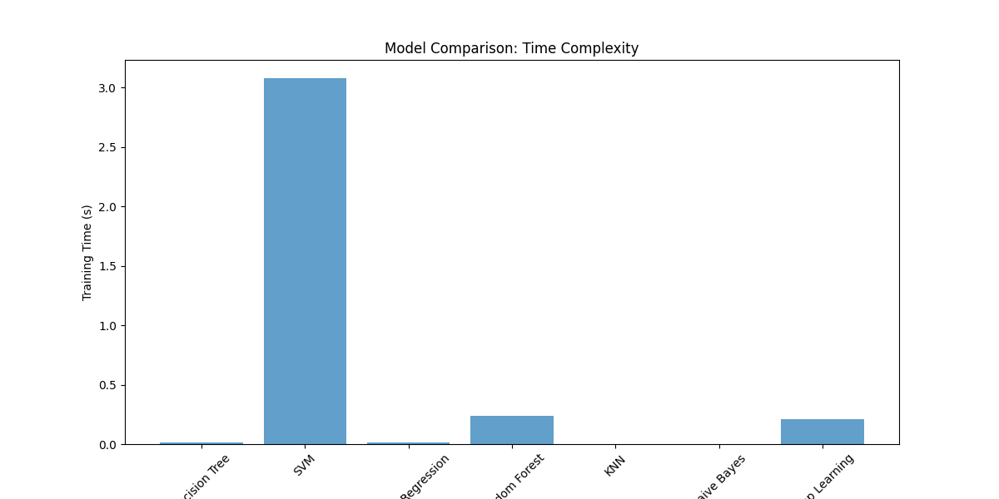
Comparison based on Time Complexity

Slide 13
Conclusion
According to the results of our experiments and evaluating algorithm using Confusion Matrix, the Naive Bayes algorithm outperforms Decision Tree, SVM, Logistic Regression, Random Forest, KNN, Naive Bayes, Deep Learning with the value of 76.62 percent accuracy, 66.10 percent precision, and 70.91 percent recall in Naive Bayes.
As a result, it can be concluded that the Naive Bayes algorithm is preferable to the Decision Tree, SVM, Logistic Regression, Random Forest, KNN, Naive Bayes, Deep Learning algorithm for predicting diabetes using the Pima Indians dataset.

Slide 14
Thank You

